Slide 1

Patient Waiting List Insights
A Power BI Analysis and Report

Slide 2
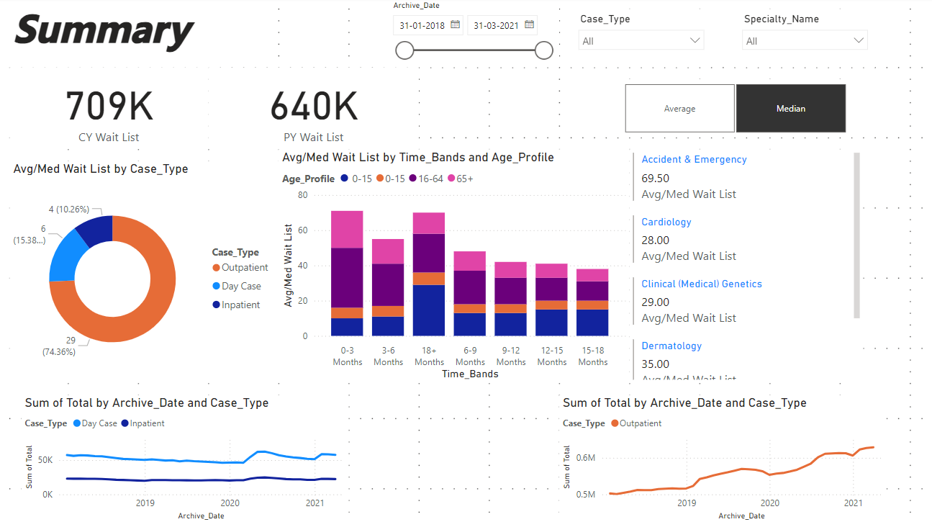

Slide 3
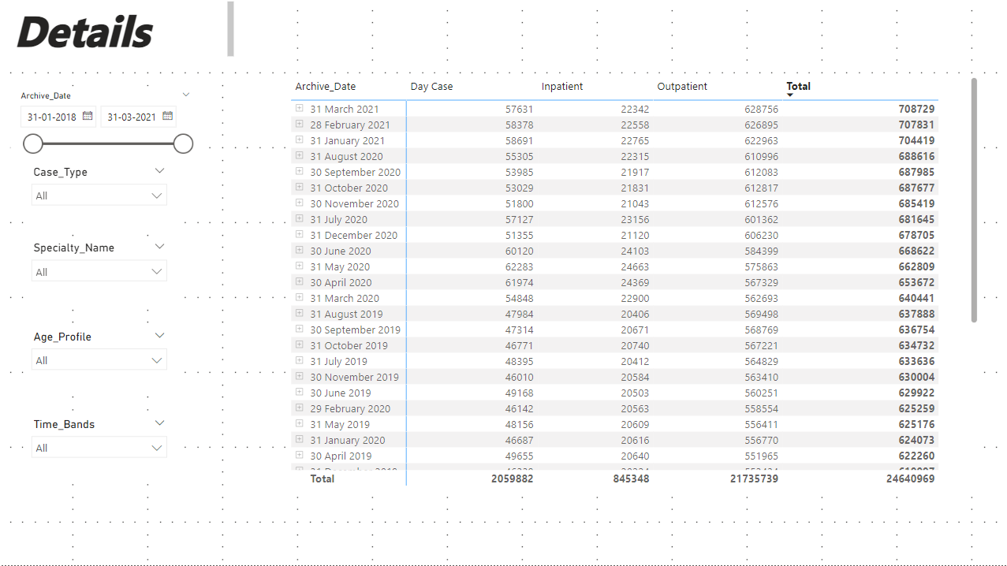

Slide 4
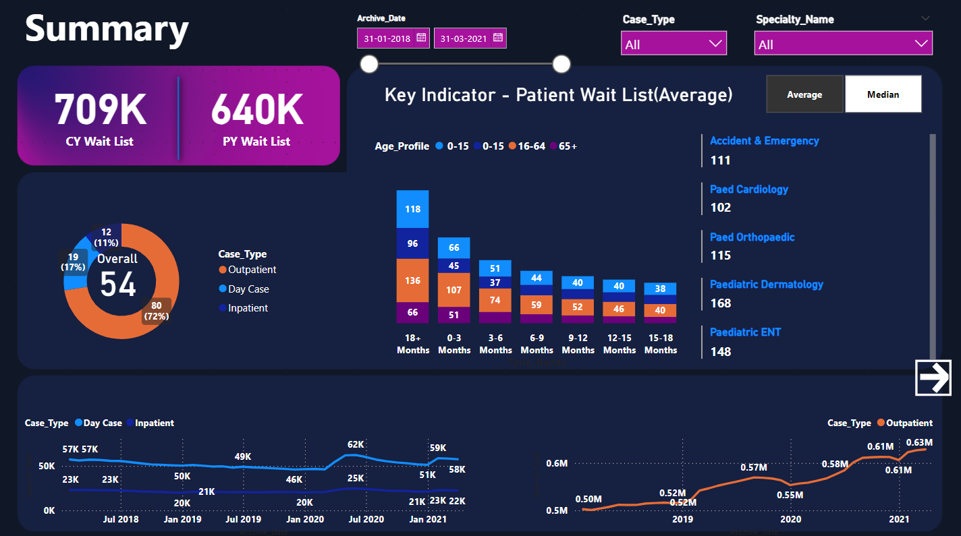

Slide 5
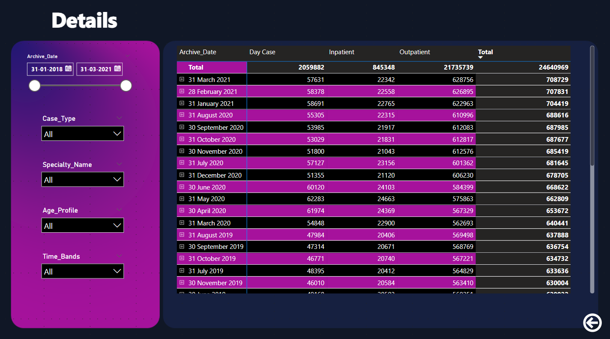

Slide 6
